Slide 1
Centralized Application-Context Aware Firewall
CSE7101- Capstone Project
Review-1
Batch Number: IST_33
Under the Supervision of,
Dr. Poornima S
Associative Professor
School of Computer Science and Engineering
Presidency University
Roll Number | Student Name
20221IST0109 20221IST0100 20221IST0114 | SANJANA K HARINI K HEGDE SNEHA S
Name of the Program: Information Science and Technology
Name of the HoD: Dr. Pallavi R
Name of the Program Project Coordinator: Ms. Benitha Christinal J , Associative Professor(SoCSE)
Name of the School Project Coordinators: Dr. Sampath A K , Dr. Geetha A

Slide 2
Content.
Problem Statement
Objectives
Background and Related work for title Selection
Analysis of Problem Statement
Innovation or Novel Contributions
Git-hub Link
Timeline of the Project
References

Slide 3
Problem Statement Number: PSCS_365
Problem Description:
Develop a context-aware application firewall for endpoints that can identify and control each application’s access to external networks. The firewall will allow granular restrictions on domains, IPs, and protocols, managed via a centralized web console. An endpoint agent will enforce policies, log application network usage, and send data to the central server. Using AI/ML, the system will detect abnormal traffic behavior and generate alerts.

Slide 4
Objectives.
Develop a context-aware firewall agent that can monitor and control application-level network access on endpoints.
Provide granular access control by restricting applications based on domains, IP addresses, and protocols.
Design a centralized web console to manage firewall policies, endpoints, and applications from a single interface.
Collect and analyze per-application network usage logs for better visibility and decision-making.
Implement AI/ML-based anomaly detection to identify abnormal traffic patterns and generate alerts.
Ensure compatibility with Windows endpoints (with optional Linux support).
Enable scalability and ease of deployment for use in enterprise environments.

Slide 5
Background and Related work
Background:
Modern organizations rely heavily on multiple applications such as Zoom, Teams, Dropbox, and browsers for daily operations. While these applications enhance productivity, they also introduce significant security risks. Traditional firewalls typically filter traffic based on ports or IP addresses, without visibility into which application is generating the traffic. This limitation allows malicious or unauthorized applications to communicate externally without detection, and managing separate firewall rules for different applications across endpoints becomes difficult. Existing solutions like Windows Firewall, network firewalls, and anomaly detection tools address parts of the problem, but none provide a centralized, context-aware, application-level firewalling solution

Slide 6
Background and Related work(continued)
Related work:
Windows Firewall / iptables (Linux): Provide rule-based blocking, but policies are hard to manage across many endpoints.
Next-Generation Firewalls (Palo Alto, Cisco, Fortinet): Can detect applications, but are expensive and focused at network edges, not endpoints.
AI/ML intrusion detection systems: Research shows ML models can detect abnormal traffic, but they are not yet integrated into endpoint firewalls.
Our project aims to bridge these gaps by creating a lightweight, centralized, AI-powered application firewall for endpoints.

Slide 7
Analysis of Problem Statement
Technology Stack Components:
Windows Service (Agent – .NET/Win32 APIs):
Runs in the background on each computer, collects system and network data, and communicates with the server.
Secure REST APIs (Communication Layer):
Provides a safe channel (HTTPS, authentication) for agents to send data and receive instructions from the central server.
Central Web Dashboard (React + Django/Node.js):
Web-based interface where admins log in to view system health, reports, and manage services across all machines.
Machine Learning Frameworks (scikit-learn, TensorFlow):
Analyze collected data to detect anomalies, predict issues, and provide smart insights beyond raw monitoring.

Slide 8
Analysis of Problem Statement
Software and Hardware Requirements:
Windows Agent (Clients)
Software: .NET Framework / .NET 6+, Win32 APIs
Hardware: 2-core CPU, 4 GB RAM, 20 GB disk
Server (Backend + APIs)
Software: Django/Node.js, PostgreSQL/MySQL, Linux/Windows Server
Hardware: 4–8 cores, 8–32 GB RAM, 100–500 GB SSD (scales with agents)
Web Dashboard (Frontend)
Software: React.js, Nginx/Apache, modern browser
Hardware: Standard server/VM, similar to backend
Machine Learning Layer
Software: Python 3.9+, scikit-learn, TensorFlow, Jupyter
Hardware: 8+ cores, 16 GB RAM, GPU (NVIDIA) for heavy training

Slide 9
Innovation or Novel Contributions
User Behavior + Application Context Monitoring:
Most firewalls only look at network traffic.
Innovation: Combine user behavior analytics with app traffic.
Zero-Trust Integration (Per-App Micro-Segmentation):
Apply zero-trust principles at the application level.
Each app is given a least-privilege network access profile.
Gamification Dashboard for Security Teams (super unique idea)
Turn anomaly detection into a gamified dashboard for SOC teams.
Ex: Critical alerts score higher “threat points,” making monitoring more engaging and reducing fatigue.

Slide 10
Github Link
Git-hub Link:
https://github.com/Sanjanaholla/PSCS-365-Centralized-Application-Context-Aware-Firewall

Slide 11
References (IEEE Paper format)
[1] K. Singh and S. Silakari, “A survey of cyber-attack detection systems using machine learning,” International Journal of Computer Applications, vol. 45, no. 17, pp. 25–32, May 2021.
[2] Palo Alto Networks, “Next-Generation Firewall (NGFW) Overview,” Palo Alto Networks, 2023. [Online]. Available: https://www.paloaltonetworks.com/network-security
[3] Z. Noor, S. Hina, F. Hayat, and G. A. Shah, “An intelligent context-aware threat detection and response model for smart cyber-physical systems,” Internet of Things, vol. 23, p. 100843, 2023.

Slide 12
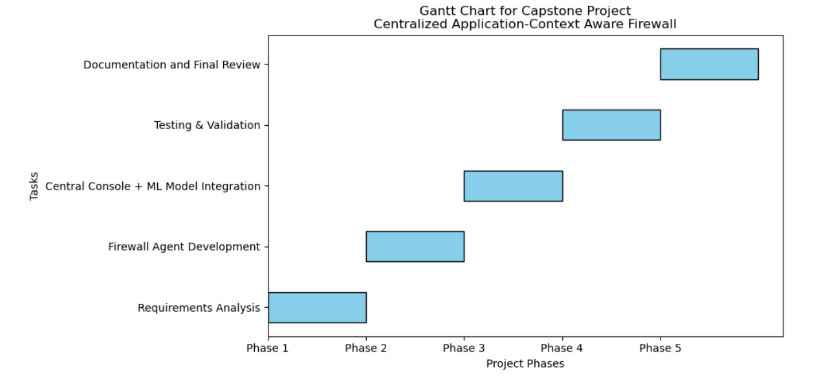
Timeline of the Project (Gantt Chart)

Slide 13


